Slide 1
UMET9U-30-1- Professional Skills for Banking and Finance Lecture 9
Presented by
Reinhold Heinlein
November 2025

Slide 2
Lecture content
Graphical analysis
Bar chart, Pie chart
Line graph
Histogram
Ogive (cumulative frequency plot)
Box plot
Scatter graph

Slide 3
Graphical Presentation of Data
Data in raw form are usually not easy to use for decision making
Some type of organization is needed
Table
Graph
The type of graph to use depends on the variable being summarized and the information one tries to display

Slide 4
Tables and Graphs for Categorical Variables
Tabulating categorical data:
Decide on the number of categories and count the observations per category. Display a frequency distribution table.
Graphing categorical data:
Display bar chart or pie chart using the information from the frequency distribution table. Height of bar or size of pie slice shows the frequency or percentage for each category.

Slide 5
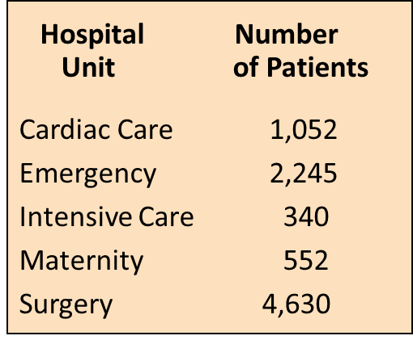

Bar Chart Example

Slide 6
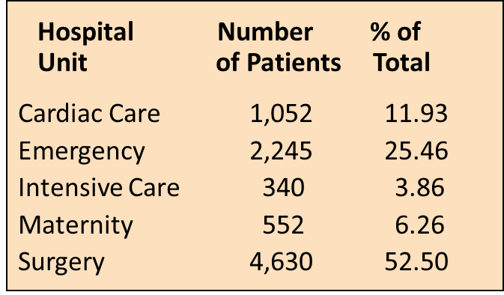
Pie Chart Example

Slide 7
Line plot for time series data
A line chart (time-series plot) is used to show the values of a variable over time
Time is measured on the horizontal axis
The variable of interest is measured on the vertical axis

Slide 8
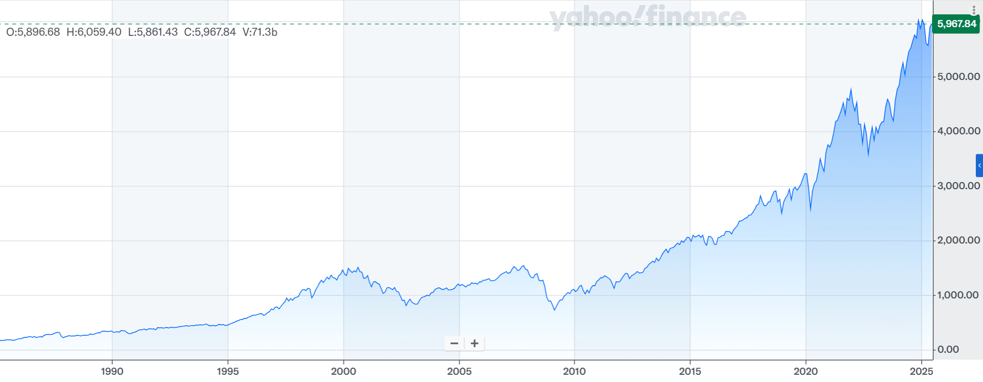
Line plot for time series data
Figure: S&P 500 stock market index, monthly frequency

Slide 9
Graphs to describe univariate numerical variables
Histograms are a graphical display of frequency distribution tables.
Ogives show cumulative distribution tables.
Box plots graphically display certain descriptive statistics, like lower and upper quartiles, medium, minimum and maximum, and also outlier observations.

Slide 10
What is a frequency distribution table?
A frequency distribution is a list or a table …
containing class groupings (categories or ranges within which the data fall) ...
and the corresponding frequencies with which data fall within each class or category
A frequency distribution is a way to summarize data
The distribution condenses the raw data into a more useful form...
and allows for a quick visual interpretation of the data

Slide 11
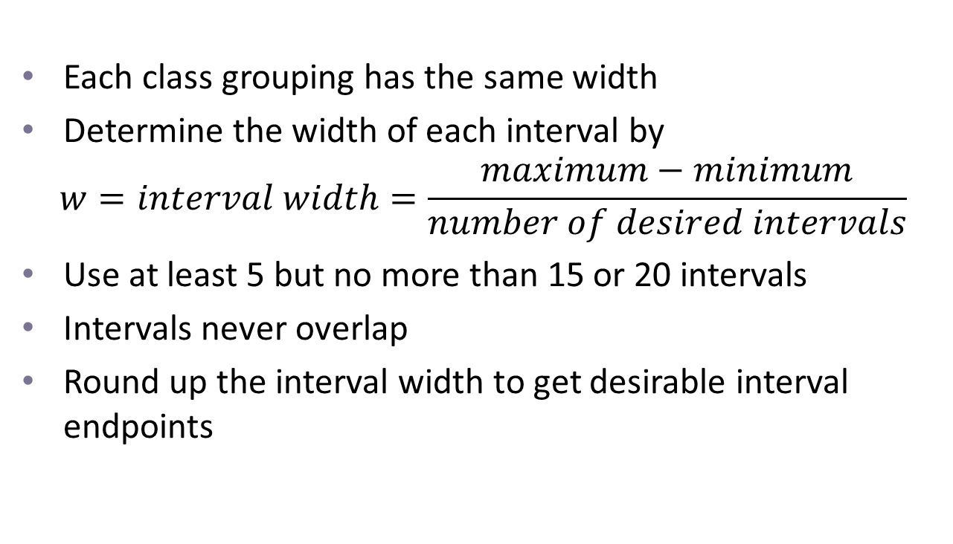
Class intervals and class boundaries of frequency distribution tables?
Each class grouping has the same width
Determine the width of each interval by
$$w=interval width=\frac{maximum−minimum}{number of desired intervals}$$
Use at least 5 but no more than 15 or 20 intervals
Intervals never overlap
Round up the interval width to get desirable interval endpoints

Slide 12
Frequency distribution example
Example: A manufacturer of insulation randomly selects 20 winter days and records the daily high temperature in Fahrenheit
24, 35, 17, 21, 24, 37, 26, 46, 58, 30,
32, 13, 12, 38, 41, 43, 44, 27, 53, 27

Slide 13
Frequency distribution example
Sort raw data in ascending order: 12, 13, 17, 21, 24, 24, 26, 27, 27, 30, 32, 35, 37, 38, 41, 43, 44, 46, 53, 58
Find range: 58 - 12 = 46
Select number of classes: 5 (usually between 5 and 15)
Compute interval width: 10 (46/5 then round up)
Determine interval boundaries: 10 but less than 20, 20 but less than 30, . . . , 50 but less than 60
Count observations & assign to classes

Slide 14
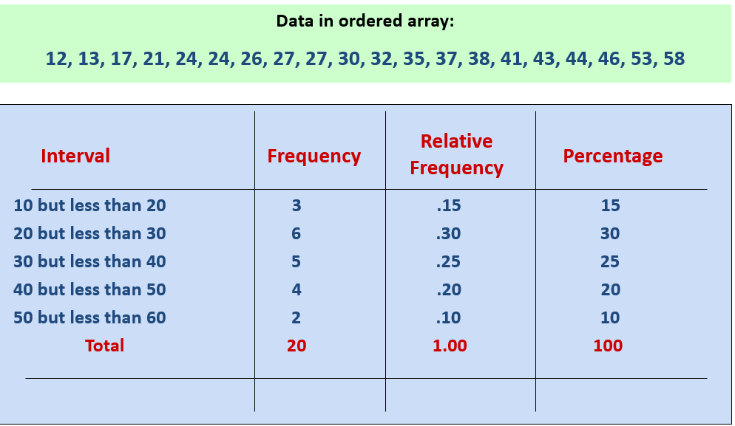
Frequency distribution example

Slide 15
Histogram
A graph of the data in a frequency distribution is called a histogram
The interval endpoints are shown on the horizontal axis
the vertical axis is either frequency, relative frequency, or percentage
Bars of the appropriate heights are used to represent the number of observations within each class

Slide 16
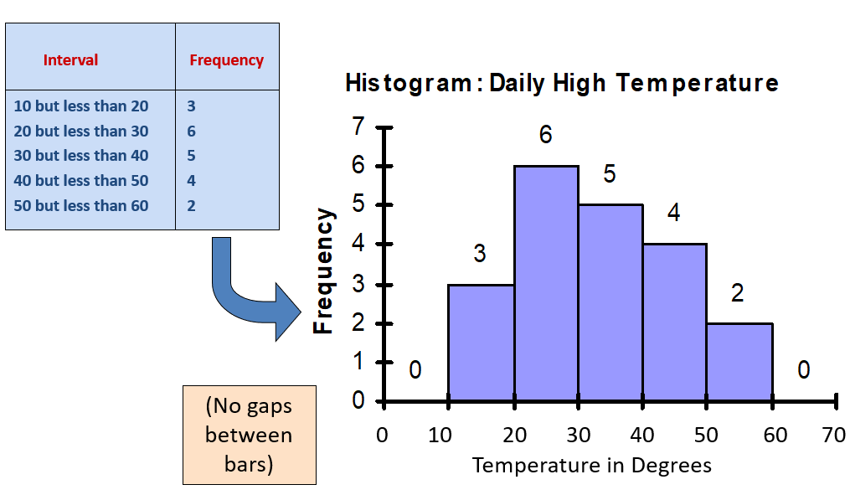
Histogram Example

Slide 17
How many class intervals?
Many (Narrow class intervals)
may yield a very jagged distribution with gaps from empty classes
Can give a poor indication of how frequency varies across classes
Few (Wide class intervals)
may compress variation too much and yield a blocky distribution
can obscure important patterns of variation.

Slide 18
Distribution shape
The shape of the distribution is said to be symmetric if the observations are balanced, or evenly distributed, about the centre.

Slide 19
Distribution shape
The shape of the distribution is said to be skewed if the observations are not symmetrically distributed around the centre.
A positively skewed distribution (skewed to the right) has a tail that extends to the right in the direction of positive values.
A negatively skewed distribution (skewed to the left) has a tail that extends to the left in the direction of negative values.

Slide 20
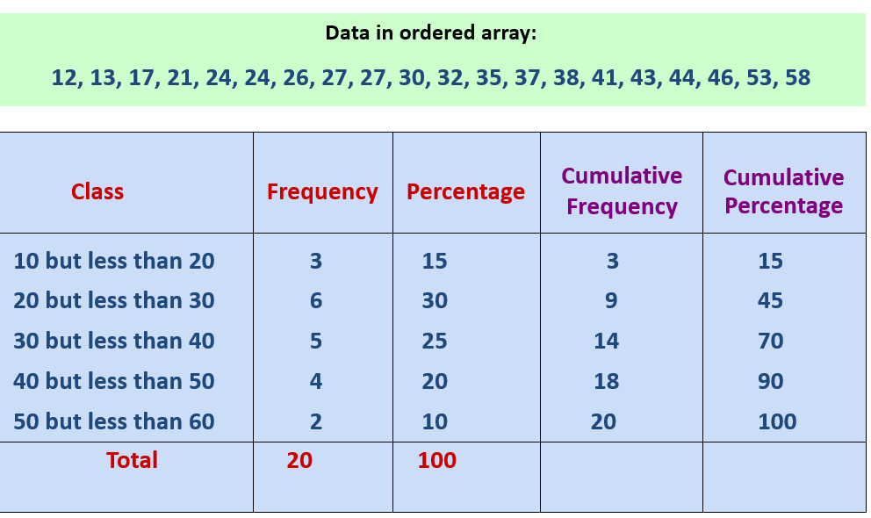
The cumulative frequency distribution

Slide 21
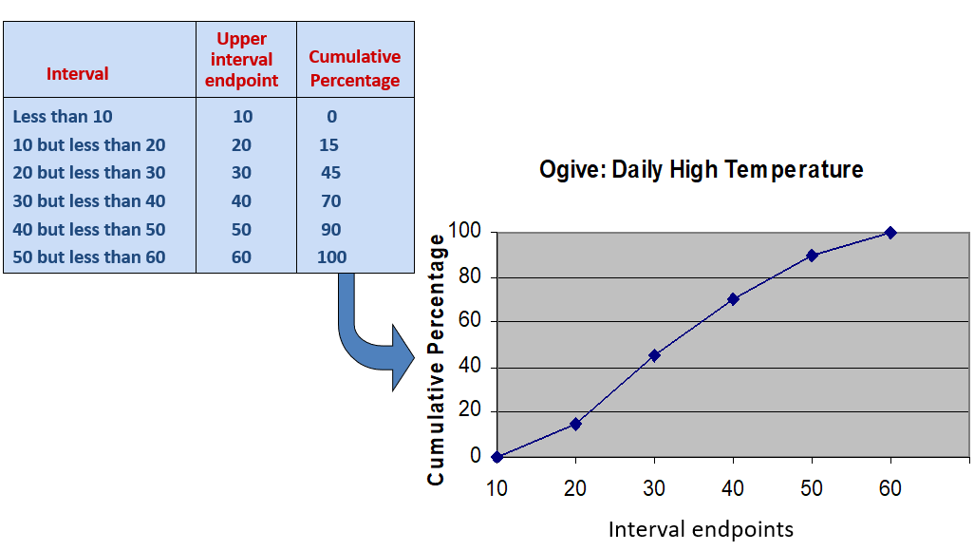
The ogive - graphing cumulative frequencies

Slide 22
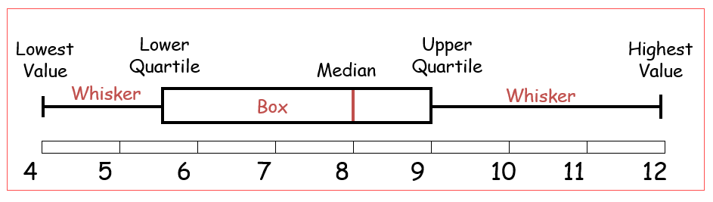
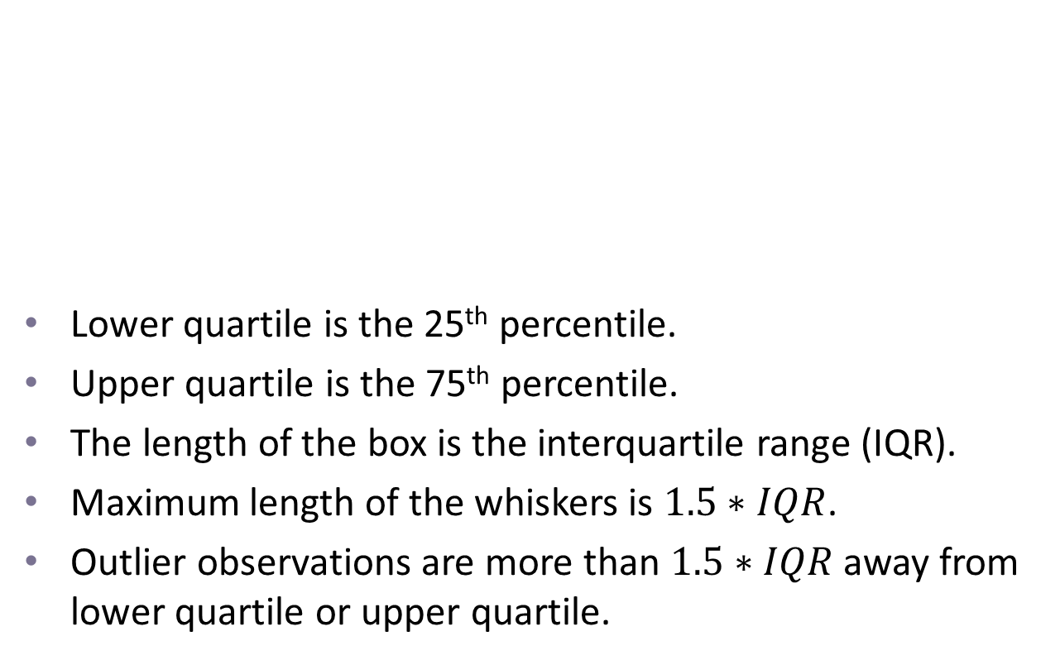
The box plot (Box and Whisker Diagram)
Lower quartile is the 25th percentile.
Upper quartile is the 75th percentile.
The length of the box is the interquartile range (IQR).
Maximum length of the whiskers is $1.5∗IQR$.
Outlier observations are more than $1.5∗IQR$ away from lower quartile or upper quartile.

Slide 23
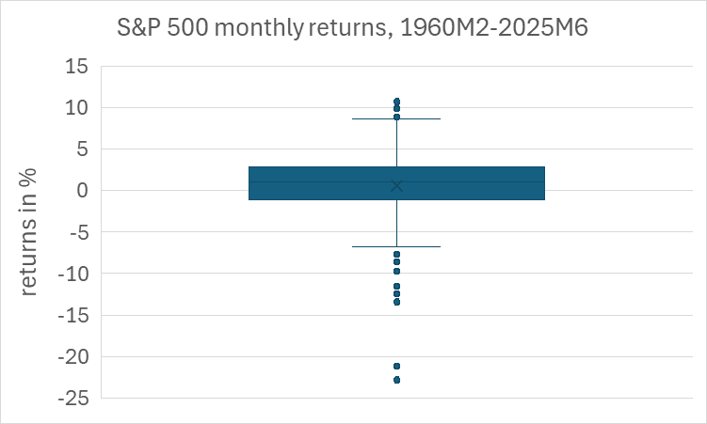
A box plot example in Excel

Slide 24
Graphs to describe relationships
Scatter graphs are used for paired observations taken from two numerical variables. One variable is measured on the vertical axis, and the other variable is measured on the horizontal axis.
The shape of the data cloud can give indication of correlation between the variables.
A trendline can be added to the graph to emphasise the relationship between the variables.

Slide 25
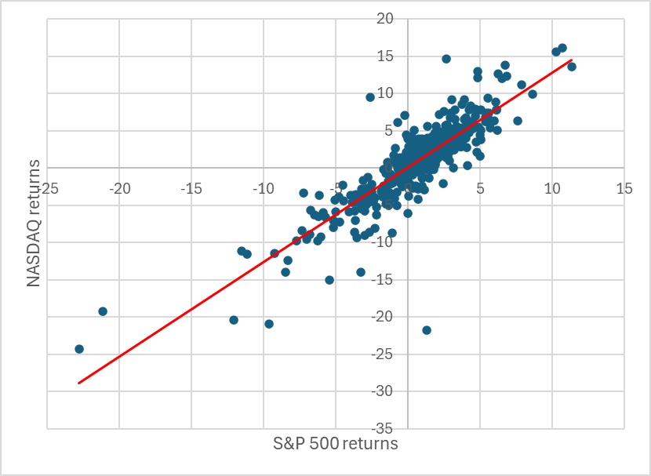
Scatter graph
Figure: Scatter graph, S&P 500 versus NASDAQ Composite, monthly returns, 1990/1 – 2025/6

Slide 26
Next Lecture
Relationships between variables
More scatter graphs
Covariance and correlation coefficients

